Slide 1
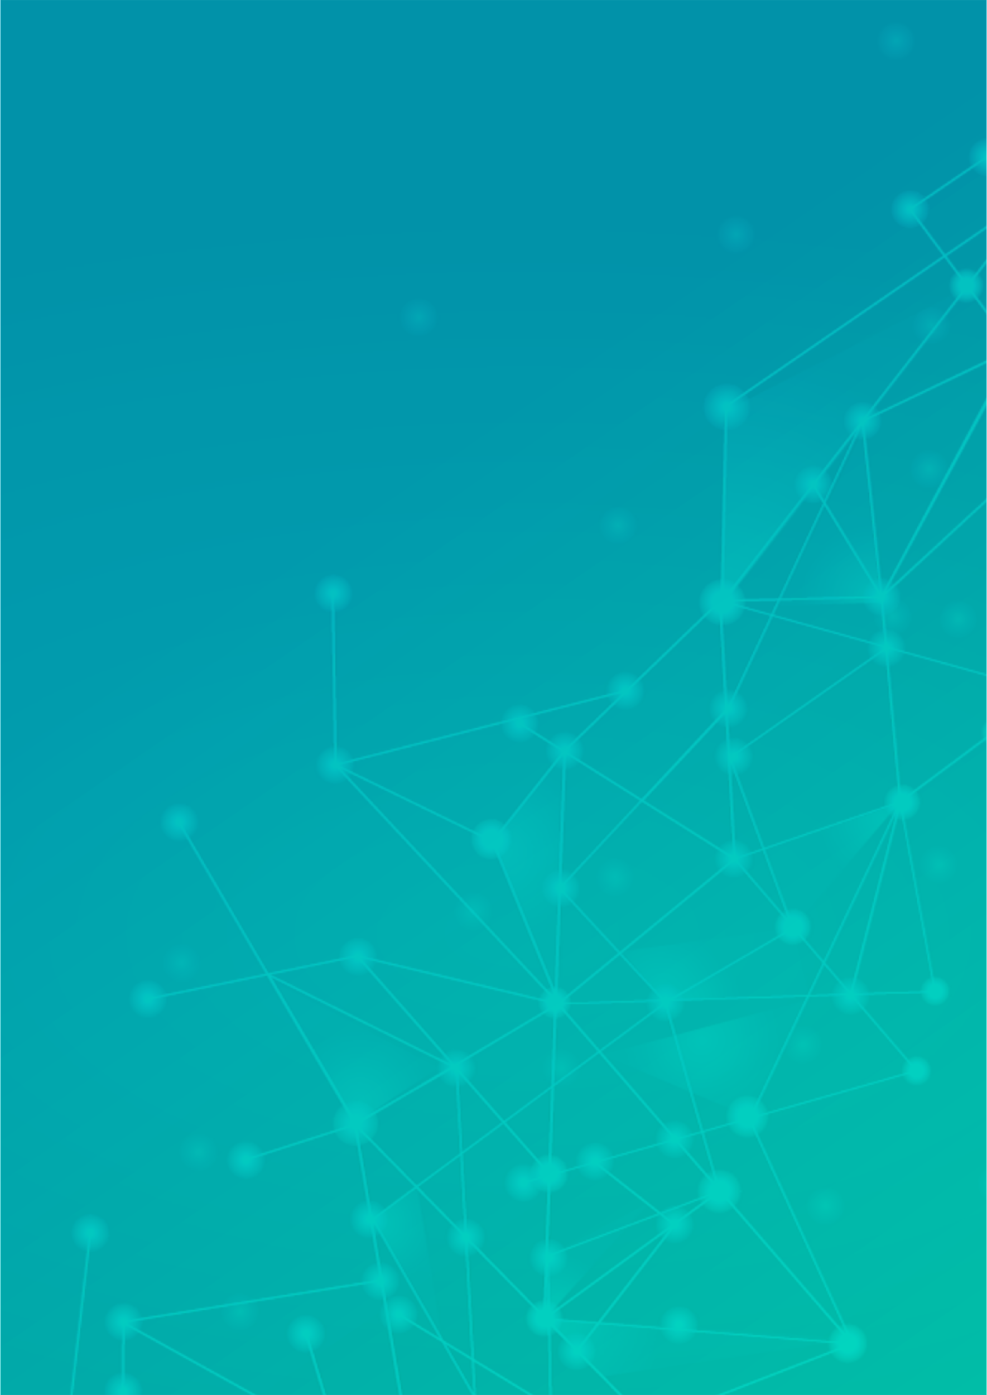
Asteroid Detector
User Manual
Author: Shyon Sable
Notes:
Preworks course home assignments

Slide 2
Table of Contents
Acknowledgements
About Me..
About My Internship Journey with Clevered
About App..
Demo Video
Toolkit Walkthrough
Contact Person

Slide 3
Acknowledgements
I would like to thank everyone who has helped me in this journey of App Development – My Parents, Ms. Sanjana and my friends who accompanied me in the journey.

Slide 4
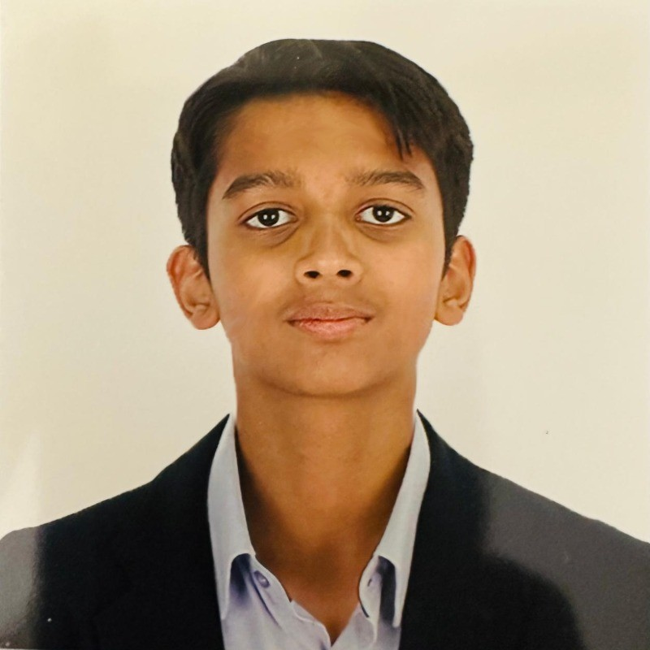
About Me..
Student’s Photograph
Student’s Introduction
I am Shyon Sable, 14 years old, and currently in Year 11 at DIA
Emirates Hills in Dubai. I am an aspiring student interested in artificial
intelligence and its applications. The field of AI captivates me because
of its potential to revolutionise industries and enhance human
capabilities. The concept of creating intelligent systems that can learn,
adapt, and solve complex problems fascinates me, and I am
particularly interested in the coding aspect of AI and it’s potential in
the future.

Slide 5
About My Internship Journey with Clevered..
My Internship Experience with Clevered
The internship journey so far has been incredibly enriching and
transformative. I have gained hands-on experience in AI coding with
Python, which has significantly deepened my understanding of
machine learning algorithms and data analysis. Working on
real-world projects has challenged my problem-solving skills and
allowed me to apply theoretical knowledge in practical scenarios.
The mentorship and collaboration have been invaluable, providing
me with insights and guidance that have enhanced my technical
knowledge. Throughout this journey, I have earned different badges
such as ‘Attentive’ and ‘Proficient’ which have allowed me to excel in
my learning journey and understand more about the world of AI.

Slide 6
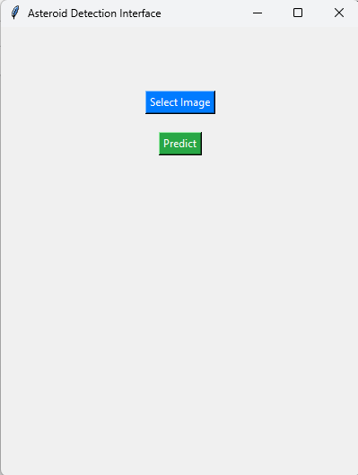
About App..
App’s Main Menu
App’s Introduction
I chose the project of integrating Artificial Intelligence into satellite
systems because of my deep fascination with space exploration and the
incredible potential of AI. By combining image recognition technology
with satellite data, I aim to develop a tool that can accurately detect
asteroids, enhancing space safety and contributing to advancements in
astronomy. This project not only aligns with my passion for AI and space
but also addresses the critical need for advanced detection systems to
protect our planet from potential asteroid impacts. Creating a reliable and
efficient detection app can improve early warning systems and help
prevent catastrophic events.

Slide 7
How do I use the App?

Slide 8
Demo Video

Slide 9
Toolkit Walkthrough
Developed In Jupyter Notebook
Google Drive Link - https://drive.google.com/drive/folders/1YwgXKqvaI75ngcHR_gcPPiO7AdvFEKjA?usp=drive_link

Slide 10
Contact Person
For Inquiries – Shyon09@gmail.com

Slide 11
Thank you!

